Slide 1
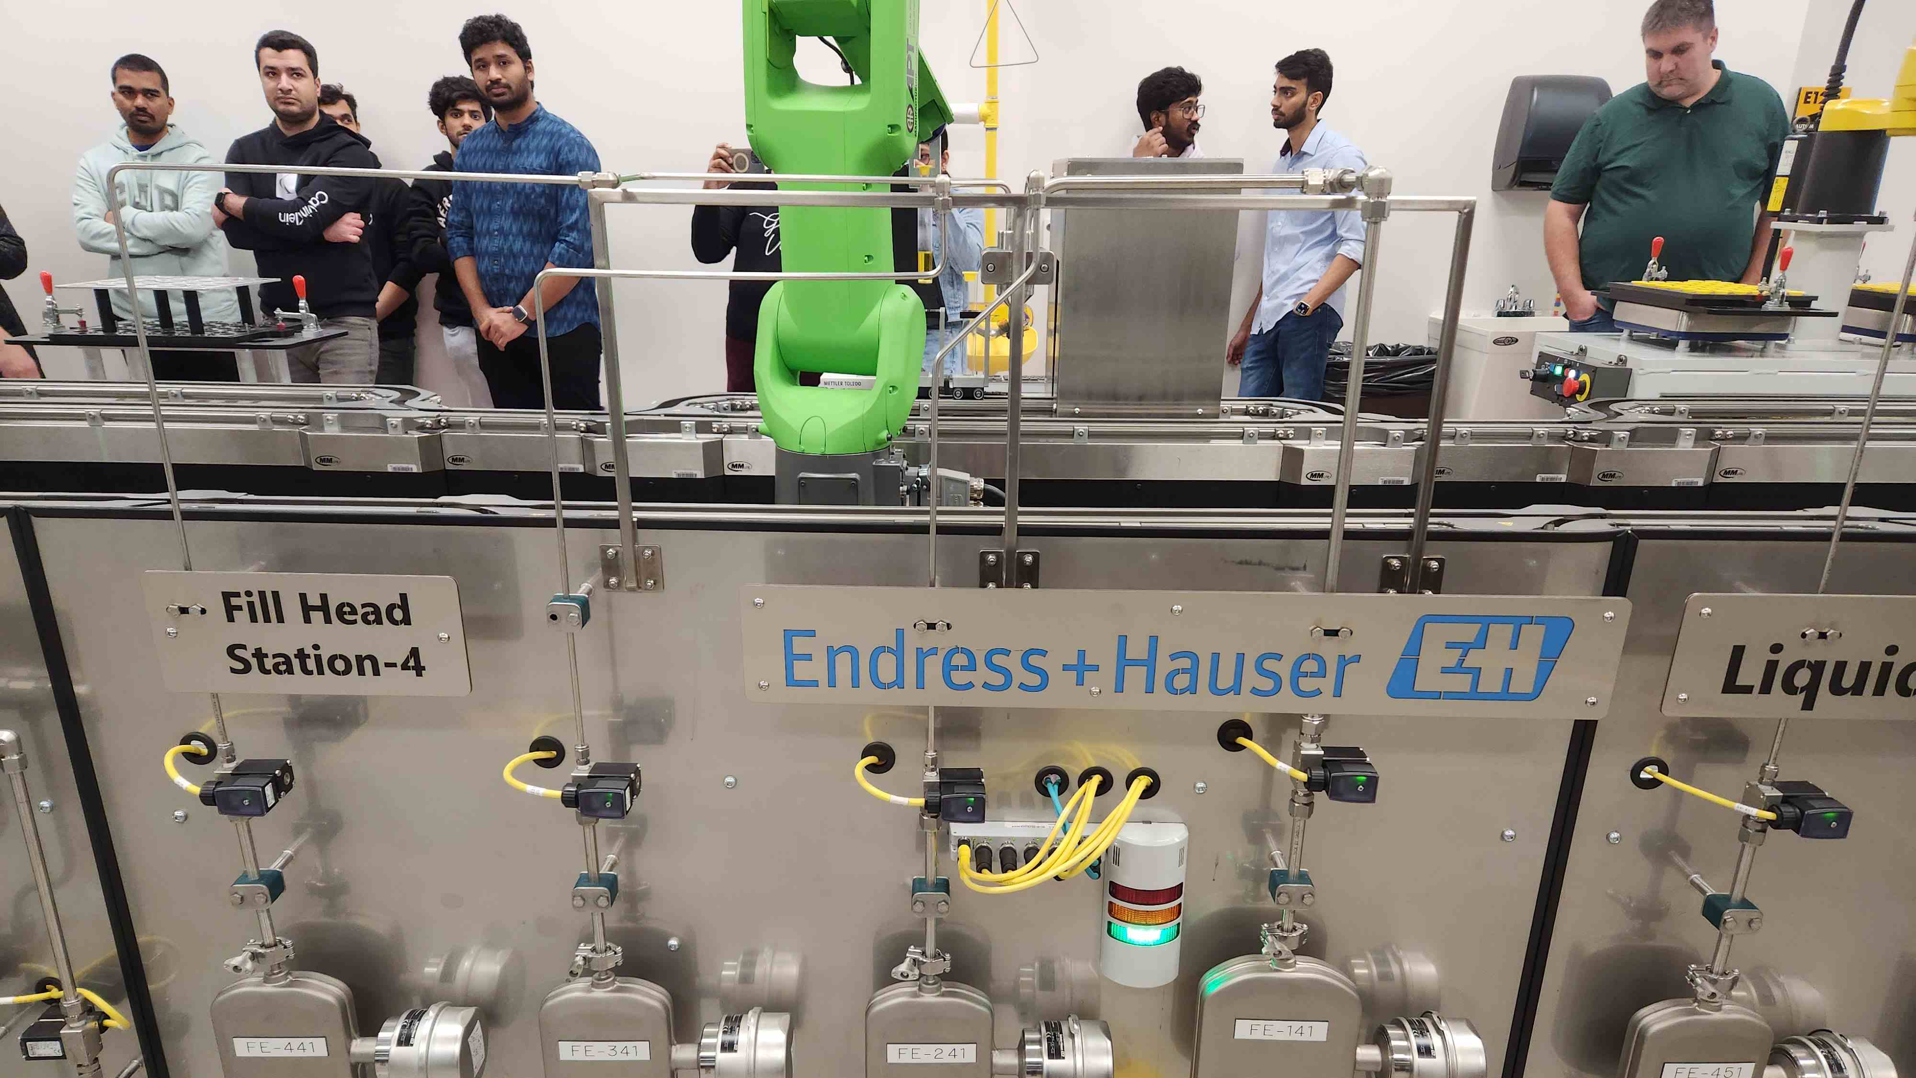
Logistic regression of wet fill station 3 failure rate.
BUS ADM 745
Aaron Cochran
Ian Brown
Varun Vijaywargi
Vamsidhar Reddy Bhavanam

Slide 2

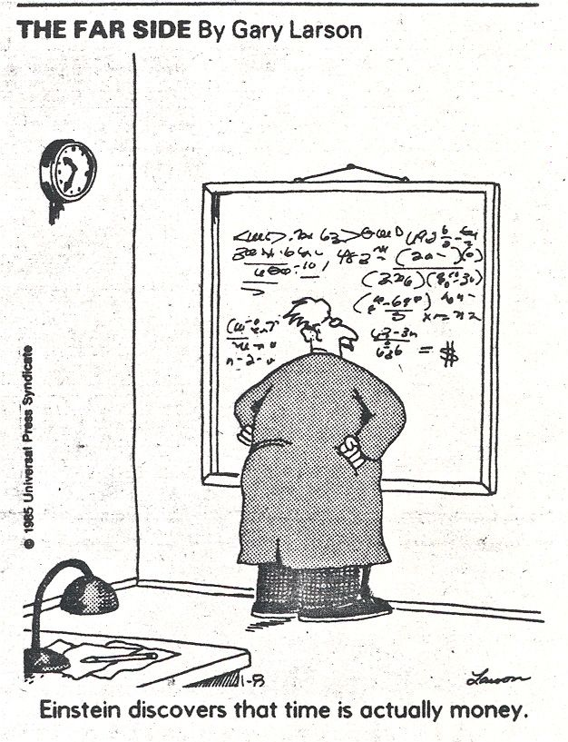
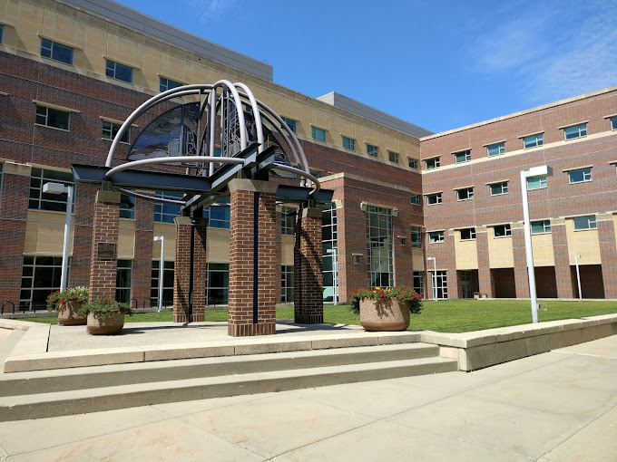
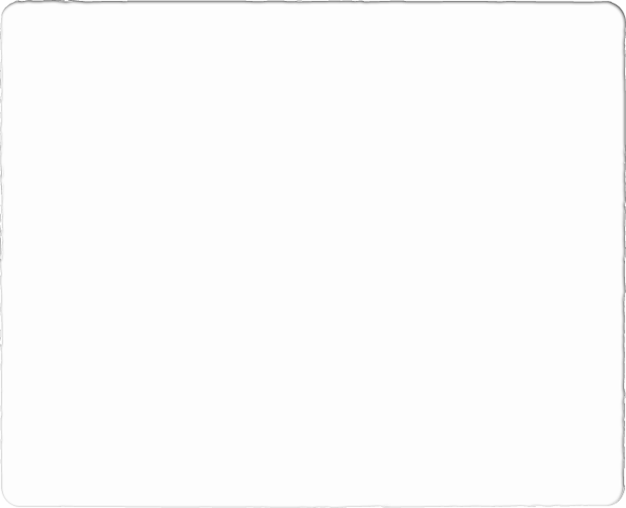
As businesspeople we knew this.

Slide 3
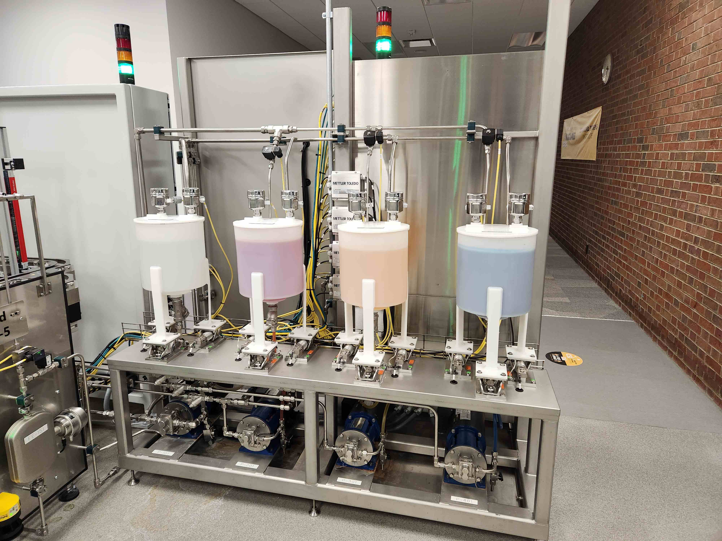
A machine AI model is a computer program or algorithm that uses statistical and mathematical techniques to analyze and learn from data and can make predictions or decisions based on that analysis.
What is a machine AI model

Slide 4
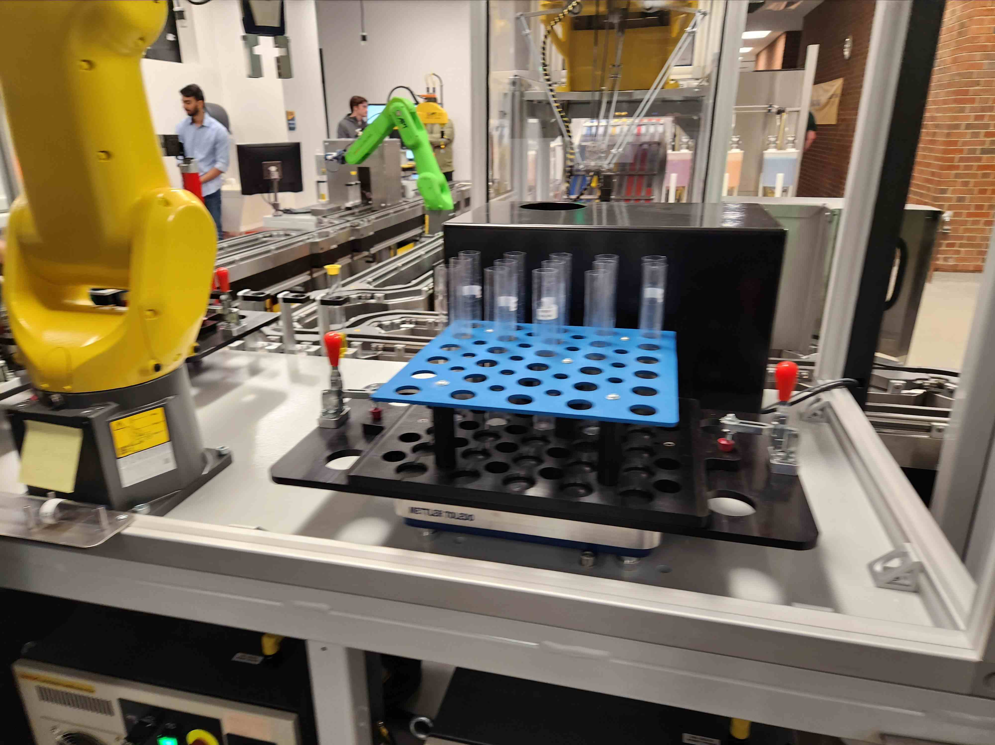
Business Idea: We propose a data-driven solution for optimizing product yield and reducing waste in manufacturing through the use of logistic regression models.
Our business idea and value proposition.
Our solution involves leveraging historical data on product weight, color, and fluid dispensing ratios to train a logistic regression model that can predict the likelihood of a failed product being salvageable through rework.
This model can then be used in real-time to identify failed products that have a high probability of being salvageable and route them to a rework station.

Slide 5
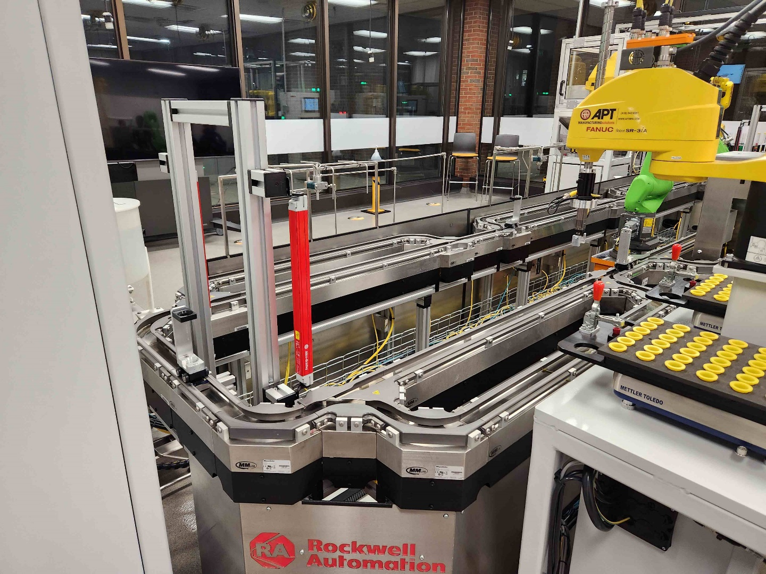
Value Proposition: Our solution offers a significant advantage to manufacturers by reducing waste also our solution helps manufacturers reduce the number of products that are discarded, leading to lower production costs and increased profitability.
Our business idea and value proposition.
Our solution is highly customizable, and we can work with manufacturers to tailor the AI models to their specific needs. With our solution, manufacturers can optimize their production processes and improve their bottom line, while also contributing to a more sustainable future.
With our solution, manufacturers can optimize their production processes and improve their bottom line, while also contributing to a more sustainable future.

Slide 6
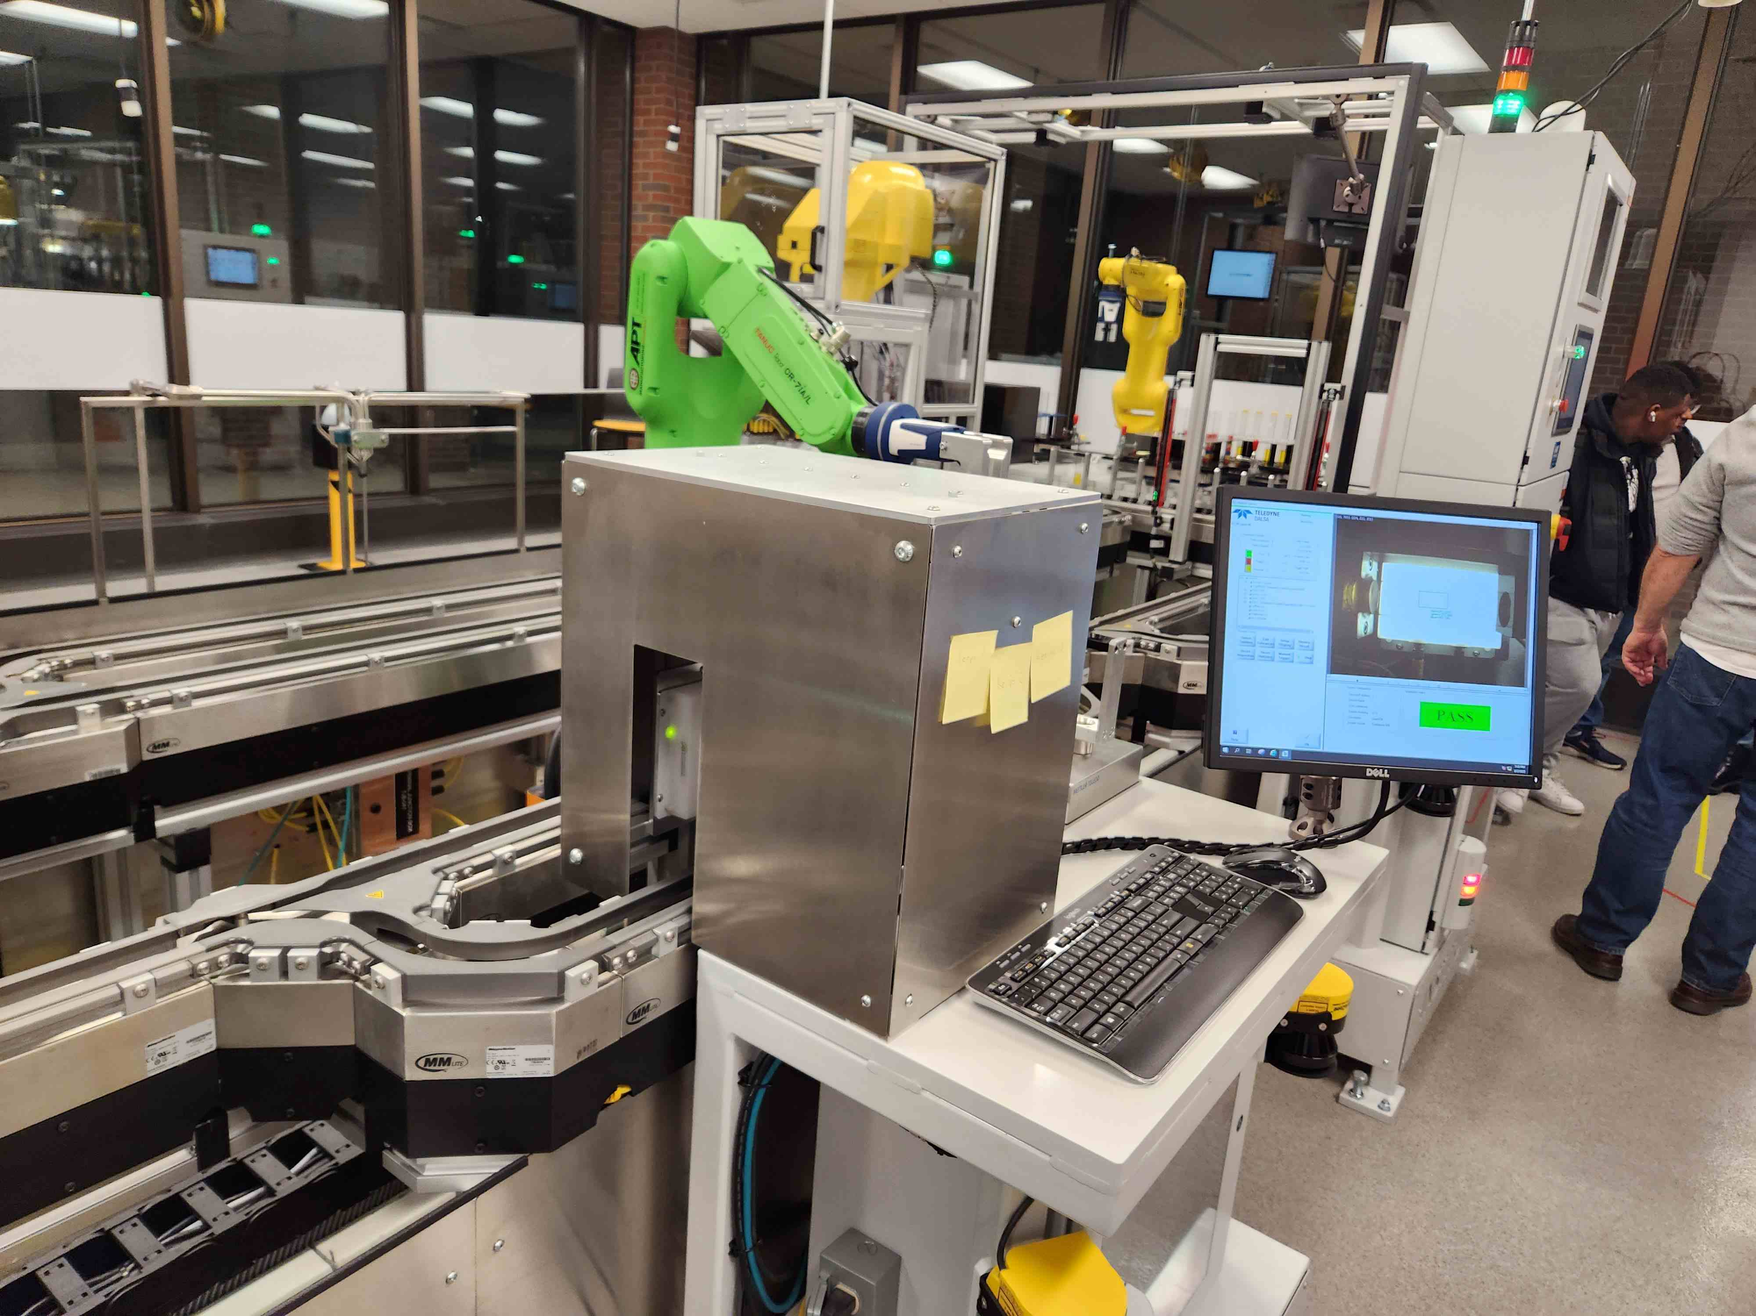
A Logistic Regression model can be trained using historical data on product weight, color, and fluid dispensing ratios to predict the likelihood of a failed product being salvageable through rework.
Machine learning problem statement
This model can then be used in real-time to identify failed products that have a high probability of being salvageable and route them to a rework station, reducing waste and increasing overall product yield.

Slide 7
In a shampoo factory, if a bottle is found to be underweight but has the correct ratios of soap, moisturizer, and fragrance, more finished shampoo product can be added to the bottle to make it the correct weight.
Problem statement analogy

Slide 8
If a shampoo bottle dispensed half the required amount of soap but had the correct amount of moisturizer and fragrance, a separate category "needs soap" would be needed to flag the product for the rework station.
Problem statement analogy
continued

Slide 9
Out of 88 inspection failures, 21 were due to weight issues and 6 of those did not complete visual inspection.
Clarification of information through data analysis and interpretation

Slide 10
Meta Data used for Training
Vial_Empty_Weight
Inspect_Station_Vision_PassFail
Inspect_Station_WeighCheck_Upper_Limit
Inspect_Station_WeighCheck_Lower_Limit
nspect_Station_WeighCheck_Data
Inspect_Station_WeighCheck_PassFail
Wet_Fill_Station3_Volume_Req_Tank100
Wet_Fill_Station3_Volume_Req_Tank200
Wet_Fill_Station3_Volume_Req_Tank300
Wet_Fill_Station3_Volume_Req_Tank400
Wet_Fill_Station3_Volume_Disp_Tank100Wet_Fill_Station3_Volume_Disp_Tank200
Wet_Fill_Station3_Volume_Disp_Tank300
Wet_Fill_Station3_Volume_Disp_Tank400
Inspect_Station_Vision_VialRGB_Red Inspect_Station_Vision_VialRGB_Green Inspect_Station_Vision_VialRGB_Blue Inspect_Station_Vision_VialRGB_Blu_Lower
Inspect_Station_Vision_VialRGB_Gre_Lower
Inspect_Station_Vision_VialRGB_Gre_Upper Inspect_Station_Vision_VialRGB_Red_Lower Inspect_Station_Vision_VialRGB_Red_Upper
Inspect_Station_Vision_PassFail

Slide 11

Due to the small sample size of 15 records, a binary classification model was used to determine whether a product is reworkable or not. With a larger dataset, additional categories could be added to classify over/underfilled subcategories and vials that fail visual inspection.

Slide 12
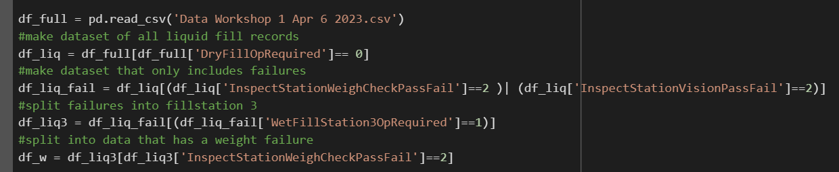
Logistic regression using python code
Read in the wet fill data then isolate the failures.

Slide 13
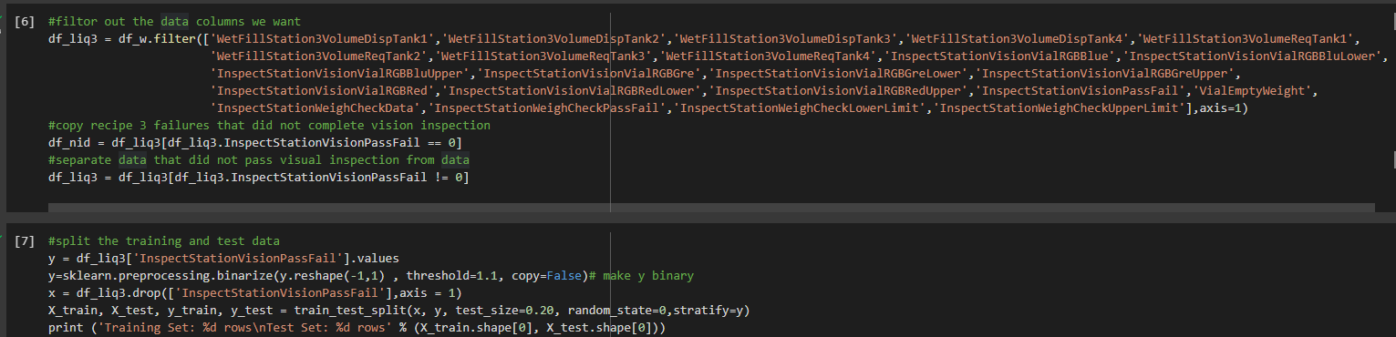
Logistic regression using python code
Separate data that did not pass inspection and build the split and training test data set 80/20.

Slide 14
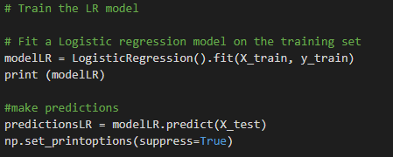
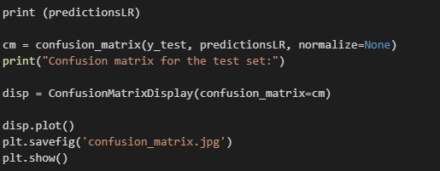
Logistic regression using python code
Fit Logistic Regression model and build confusion matrix

Slide 15
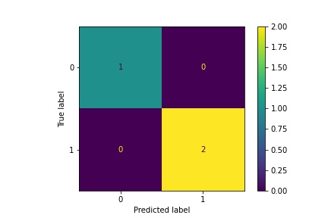
Confusion matrix
The Confusion matrix for the test set in this case shows that there were 28 true positives, 1 false positive, 74 true negatives, and 0 false negatives.
This means that the model correctly identified 28 vials that failed visual inspection and 74 that passed, while misclassifying only one vial that passed as a failure. The absence of false negatives in this matrix indicates that the model did not miss any vials that actually failed visual inspection.
Overall, this is a good performance and suggests that the logistic regression model is effective in identifying vials that are likely to fail visual inspection at the wet fill station 3.

Slide 16
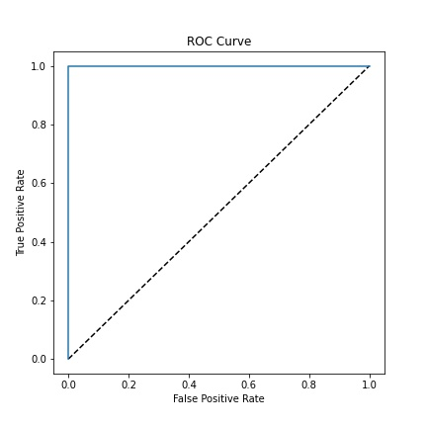
ROC Curve for Logistic regression of wet fill station 3 failure rate
This ROC curve is plotted along with a 50% diagonal line, which represents the performance of a random classifier. If the ROC curve was below the diagonal line, it indicates a poor model performance. If the ROC curve is above the diagonal line, it means that the model performs better than a random classifier.

Slide 17
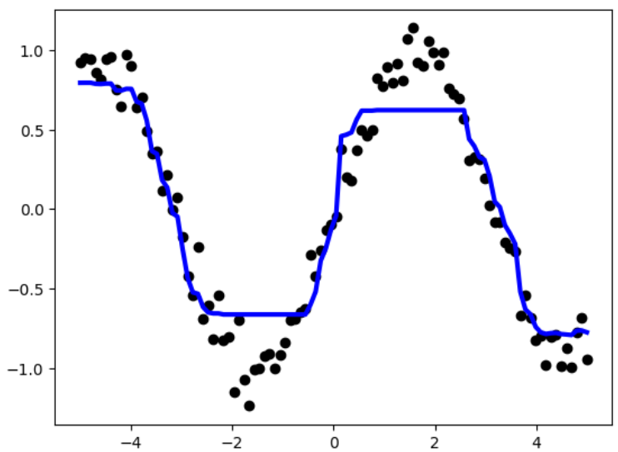
Summary and conclusions
The confusion matrix showed that the model correctly predicted 98% of the negative outcomes (no failure) and 30% of the positive outcomes (failure). The ROC curve showed that the model's performance was above chance, but it could be improved with a higher true positive rate at low false positive rates
In conclusion, this logistic regression model provided a moderate level of accuracy in predicting the outcomes of visual inspections of liquid fill vials
The results suggest that the model could benefit from additional variables or more sophisticated machine learning methods. Further analysis is necessary to improve the model's performance and optimize the inspection process.

